Slide 1
Fundamentals of QMP
Fernando Gros González
17-01-2013

Slide 2
Table of contents
Introduction
Quick deployments
Dynamic Routing Protocol
BMX6
Information sources

Slide 3

Introduction
When we talk about QMP we are referring to an operating system (firmware) used for embedded devices.
The two main advantages that it provides are:
A simple way to deploy Mesh (or Manet) networks.
A quick and easy way to expand an Internet uplink to end users.

Slide 4

Quick deployments
One of the scenarios QMP has been developed for is: Quick deployments.
Achieve the following requirements:
The deployment must be performed as fast as possible.
It must be able to be done by non-technical people.
It must be possible in most situations.

Slide 5


Dynamic Routing Protocol
The QMP team, after an extensive study decided to choose these protocols:
BMX6 as the main DRP.
OLSR6 as a backup DRP.
Babel as a backup DRP but optional.

Slide 6
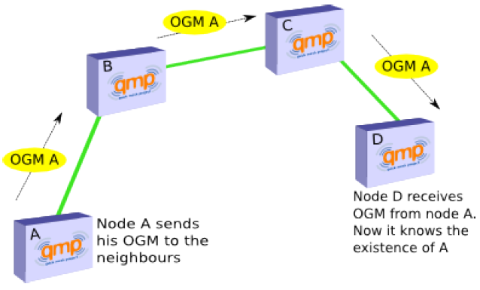
BMX6 (I)
Pro-active
Destination-sequenced, Distance-vector (DSDV)

Slide 7
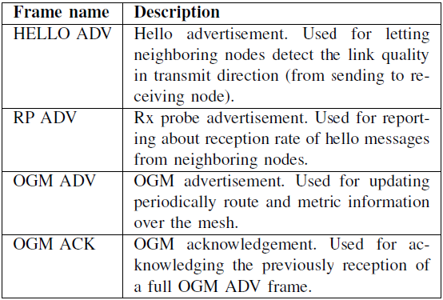
BMX6 (II)
The frames used are:

Slide 8
Information sources
Most of the information contained in this document has been extracted from qmp.cat and Pau Escrich’s PCF: ”Quick deployment network using MANET”

Slide 9
Thank you for your time!

